Slide 1
IMPORTANT NOTES:
- Slides are in no particular order
- Modify as needed for your specific audience or state
- Combine with slides from the core ASBOG presentation
1

Slide 2
Geology Careers
Mining and Energy Resources
Structural Geologist
Field Geologist
Mining and Production Geologist
Governmental - Regulatory
Academia and Research
Professor and teacher
Researcher
Museums – Outreach
Environmental Geology
Hydrogeologist
Geochemist
Governmental – Regulatory
Non-profit
Field geologist
Geohazards
Seismologist
Volcanologist
Coastal Geologist
Engineering Geologist
Governmental - Regulatory
Careers within Geology may require licensure when that work may affect the health, safety and welfare of the public and environment
2

Slide 3
Licensure Path-Process for licensure varies by state
26 licensing boards require a degree in geoscience or related field
5 states provide a path to licensure for applicants without a degree
30 licensing boards specify 30 semester or 45 quarter hours/units geology coursework
2 states allow for “applied geoscience courses under departments other than geology”
16 states provide lists of either required courses and elective courses
Passing the ASBOG® Fundamentals of Geology (FG) examination
Five years of professional experience under the direct supervision of a PG or PE
Many states allow for graduate experience to substitute for work experience, up to 2-years
Passing the ASBOG® Practice of Geology (PG) examination
Eight (8) licensing boards require some form of continuing education for license renewal
One (1) licensing board has a voluntary continuing education program
3

Slide 4
Licensure Qualified Programs?
Most States require a degree in Geology, Engineering Geology, or Geological Engineering
Public Protection
Education
Exams
Experience
Common Degree Programs Include:
Environmental Geology
Environmental Science
Geoscience
Geology
Earth and Atmospheric Science
Environmental Studies
Earth and Planetary Sciences
Geophysics
Engineering Geology
Geotechnical Engineering
Geological Engineering
Hydrogeology
4

Slide 5
What’s the problem?
Geology Boards have long recognized that there is confusion regarding the geology education requirements
Applicants misinterpreting “major in geological sciences”
The flexibility and variety of geology curricula
The lack of national program level accreditation for geology programs (ABET)
The proliferation of interdisciplinary degrees
Non-licensed professions seeking a pathway to licensure
Public Protection
Education
Exams
Experience
5

Slide 6
ASBOG Task Analysis Survey
ASBOG conducted its sixth Task Analysis Survey in 2023 by seeking feedback by licensed practicing geoscientists. The purpose is to maximize the relevance of the Fundamentals of Geology (FG) and Practice of Geology (PG) Examinations to the practice of the geological profession
PRESENTATION NAME
6

Slide 7
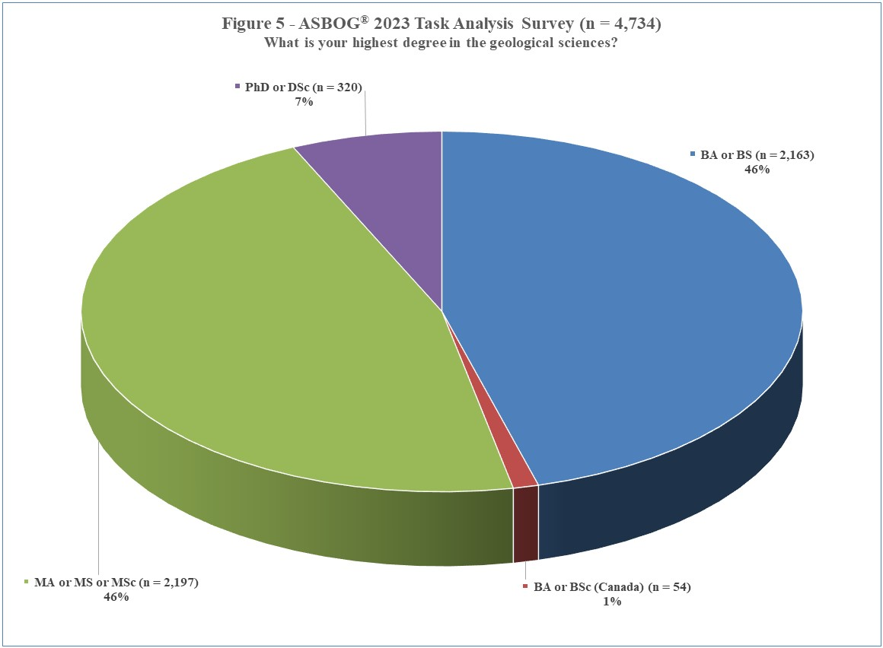
    For many practicing geologist, a bachelors or masters degree are the terminal need for workforce
    Geoscience educators, however, attain advanced graduate degrees
    Matching degree program requirements to the needs of graduates is an important consideration.
Educators
Practicing geoscientists
7
Notes:
Over 67+% of this pie chart practices geology that directly affects the health, safety and welfare of public and environment (Environmental, Engineering, Hyrdogeology)

Slide 8
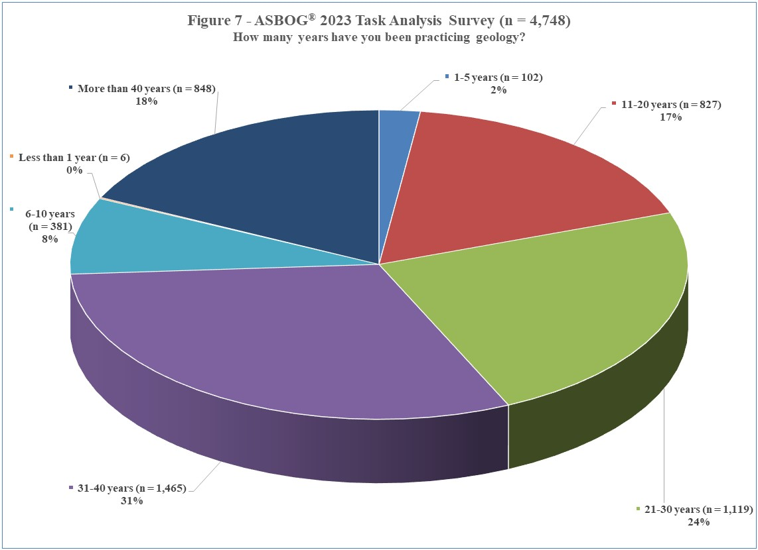
    Workforce licensure typically takes > 6 years post degree
    Aging of licensed geoscience workforce highlights need to enhance pipeline
    Working with academic institutions to emphasize the importance of licensure is vital to degree valuation
8
Notes:
Over 67+% of this pie chart practices geology that directly affects the health, safety and welfare of public and environment (Environmental, Engineering, Hyrdogeology)

Slide 9
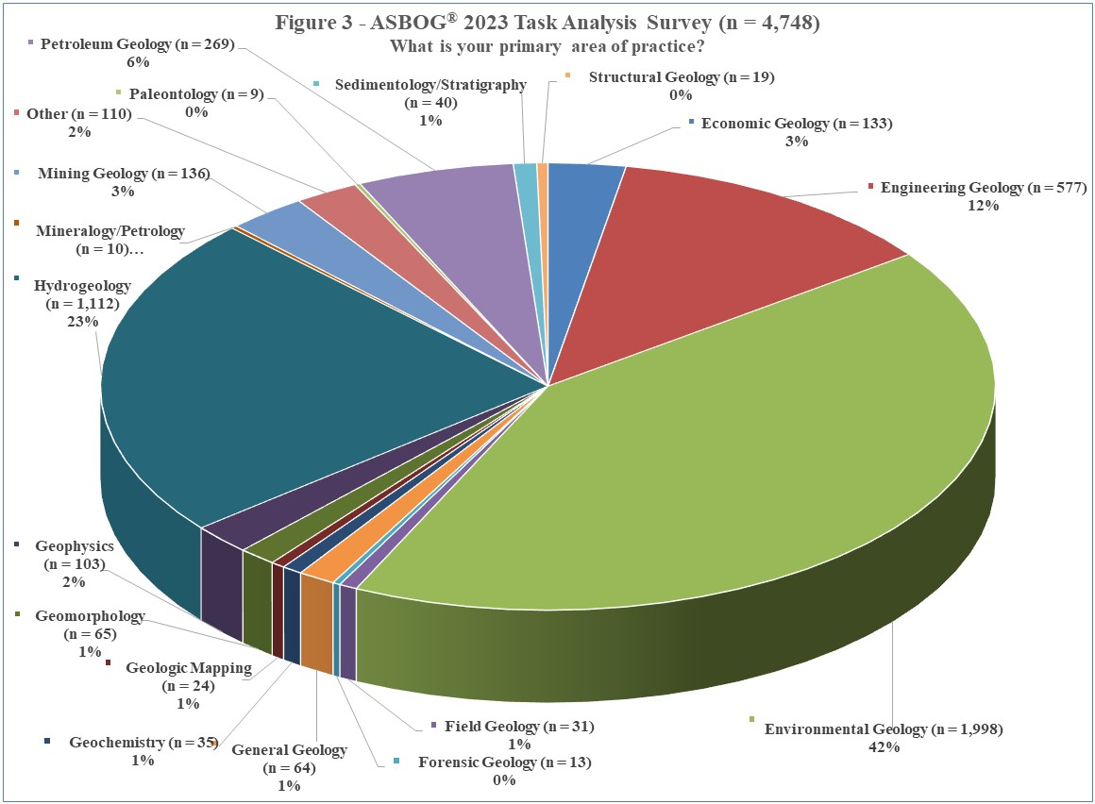
    Engineering, environmental, and hydrogeology represents the larger fraction of the geoscience workforce
9
Notes:
Over 67+% of this pie chart practices geology that directly affects the health, safety and welfare of public and environment (Environmental, Engineering, Hyrdogeology)

Slide 10
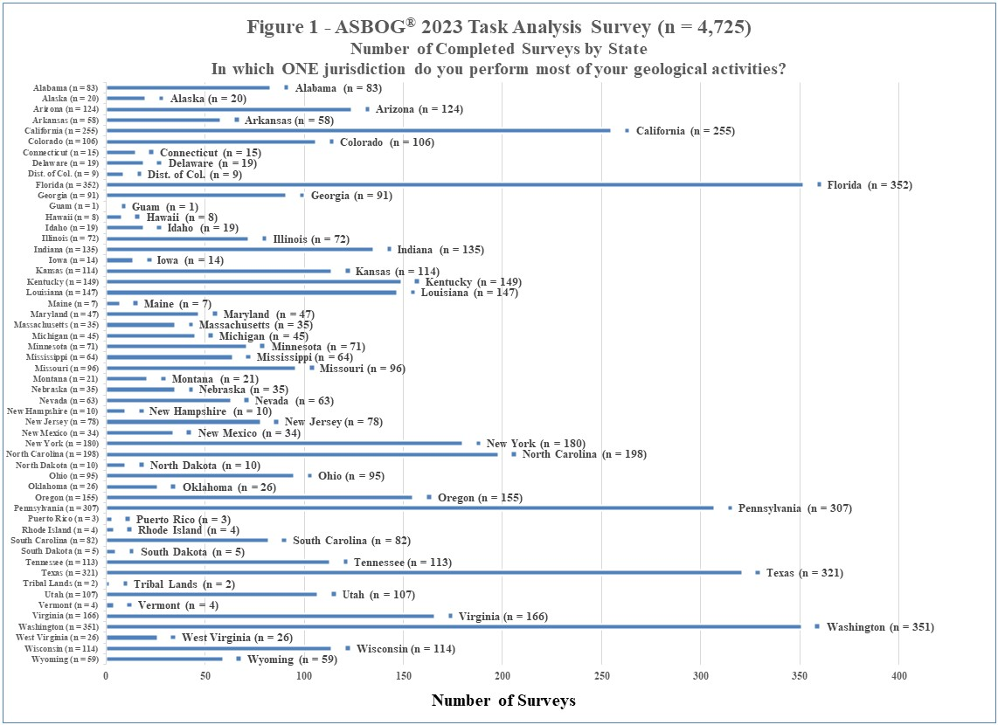
10

Slide 11
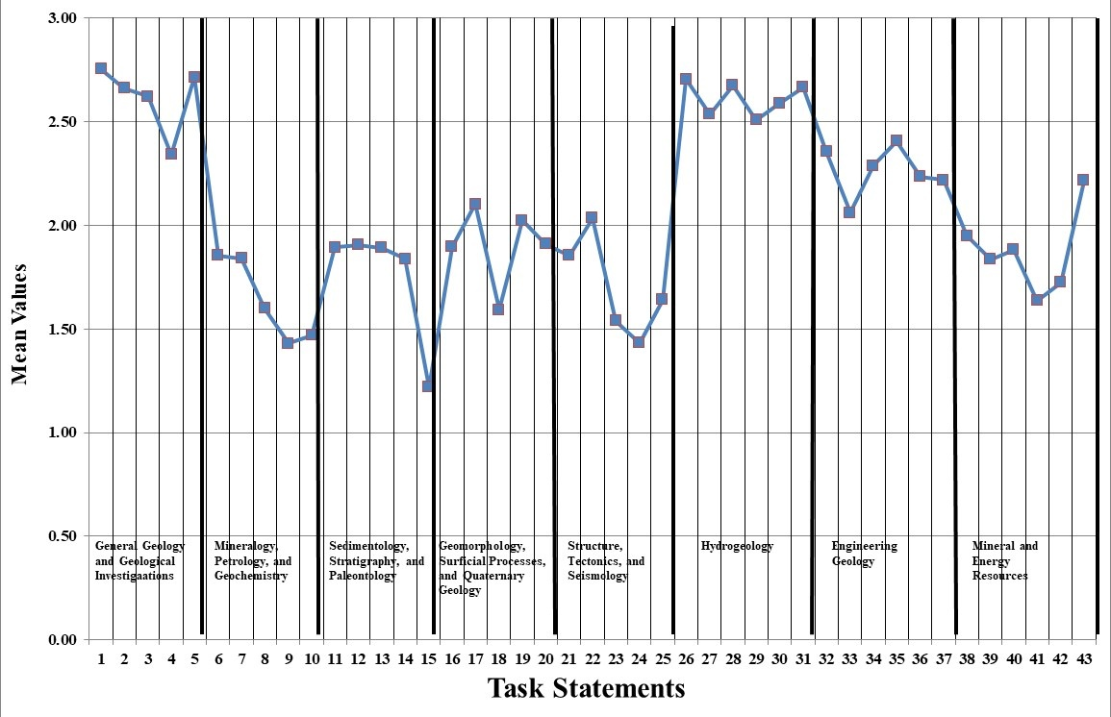
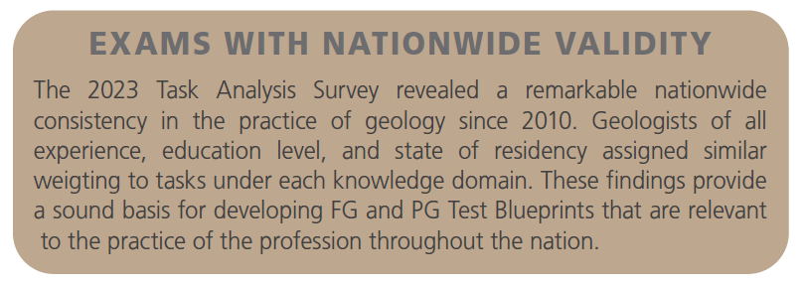
Figure 9 - ASBOG® 2023 Task Analysis Survey
Mean Values for All Task Statements for Practicing Geologists (n = 4,744)
More exam questions
Percent exam content
Fewer exam questions
Engineering Geology
Mineral and Energy Resources
11

Slide 12
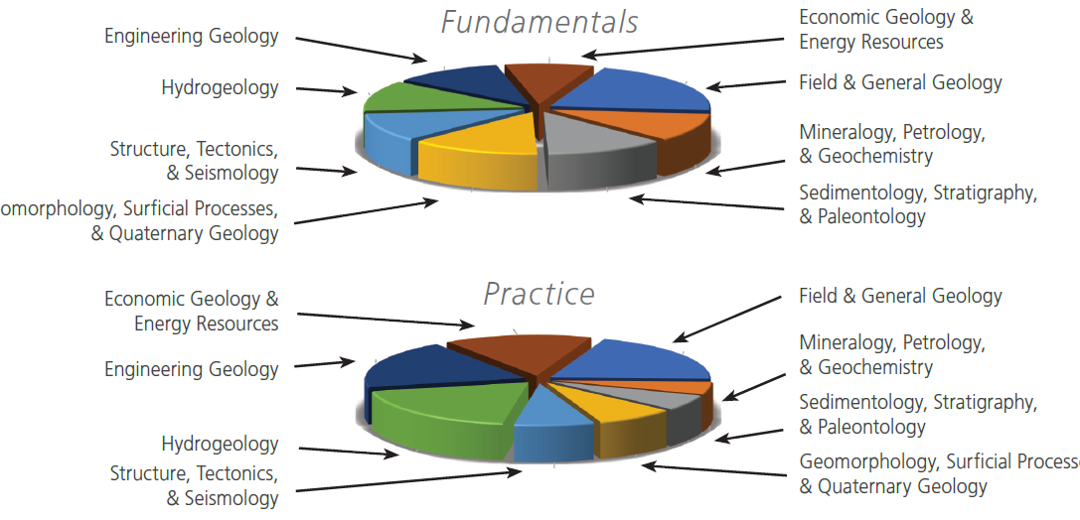
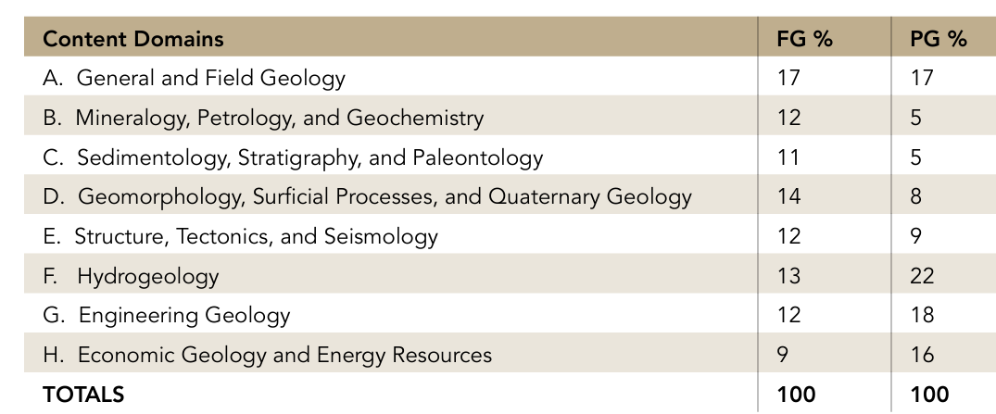
Exam Domains: Question Topics
12
    General and Field Geology is important to both exams
    Fundamentals exam is more balanced by domain
    Practice exam is more weighted toward engineering, environmental, and economic geology

Slide 13
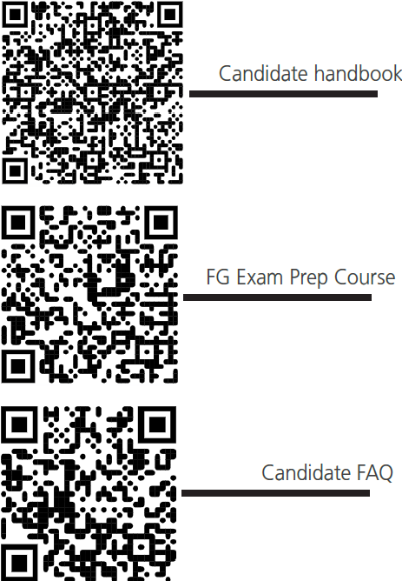
Additional Resources
    Download ASBOG’s Candidate handbook
      Includes detailed instructions for exams
      Information on blueprints and topics
      Sample questions
ASBOG offers an 8-hour FG prep course! Visit our website to register!
Visit Candidate Resources (asbog.org) for resources on preparing for your exam.
13

Slide 14
THANK YOU
https://www.asbog.org

