Slide 1
Geology Licensure in the United States
An introduction

Slide 2
IMPORTANT NOTE:
Presentation should be modified for a specific audience or state by combining these core slides with slides from the supplemental files for academic or professional audiences.
2

Slide 3
Why Geologic Licensure?
Introduction to Geologic Licensure
3

Slide 4
WHAT IS THE PUBLIC PRACTICE OF GEOLOGY?
The National Association of State Boards of Geology (ASBOG®) connects the individual state geologic registration licensing boards for the planning and preparation of uniform procedures and the coordination of geologic protective measures for the general public.
The practice of geology means the applied work in any branch of the profession of geology.
Licensure may be required when that applied work engages projects that may affect the health, safety and welfare of the public and the environment.
Geologic investigations may also have economic impacts to environmental or infrastructure projects.
Work types that may require licensure include: consultation, inspection, evaluation, planning, and investigation, including responsible supervision.
Common exemptions from licensure include:
Academia
State and Federal Government
Oil and Gas
Introduction to Geologic Licensure
4

Slide 5
Benefits of Geologic Licensure
Raises your ceiling of professional stature in the workplace
              Opens opportunities for promotion and leadership
              Allows signature authority on project deliverables
Makes you more valuable to your employer
              Promotes business expansion to new regions or contracts
              Leverages expert-level guidance and testimony
              Provides mentorship opportunities for junior staff
Puts you on equal ground with other licensed professionals
              Gives equal footing with licensed engineers and surveyors
5

Slide 6
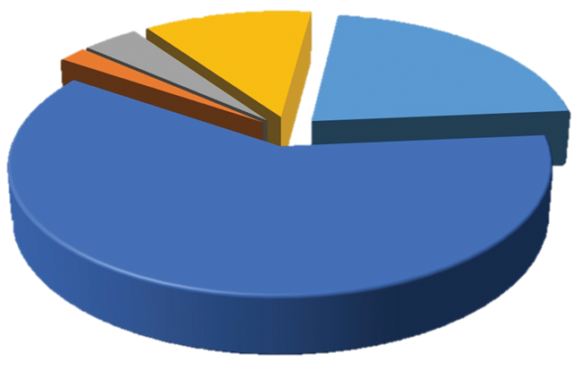
WHAT STATES HAVE LICENSURE?
State certification (n=6)
Statutory requirements (n=2)
U.S. Territory (n=1)
No licensure (n=11)
State licensure (n=31)
Introduction to Geologic Licensure
6

Slide 7
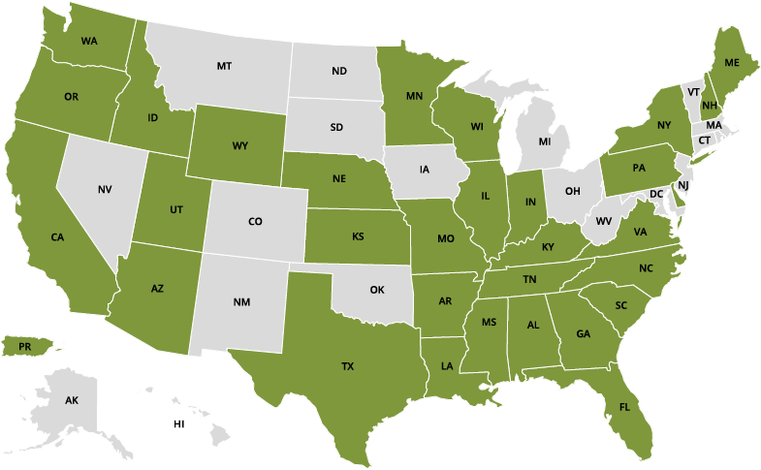
WHAT STATES HAVE LICENSURE?
Green: ASBOG Member Board State
Gray: Non-regulatory state
Introduction to Geologic Licensure
7

Slide 8
Typical requirements for state licensure
Degree in geology or related field
30+ semester hours of core competencies
Work experience under licensed geologist
Passing grade on the ASBOG FG and PG exams
Application, fee, transcripts, letters of support
Attestation of ethics
Board review and approval
Continuing education in some states
Important: Requirements for each state differ.
Introduction to Geologic Licensure
8

Slide 9
Does my degree count?
Academic programs are changing nationwide. Degree programs that qualify for licensure may include:
Geology
Geosciences
Geologic Sciences
Geologic Engineering
Earth and Planetary Sciences
Environmental Sciences
And many more...
Degree requirements have various credit hours and course requirements. Those qualifying for licensure include the following common core:
Physical Geology
Historical Geology
Mineralogy/Earth Materials
Igneous/Metamorphic Petrology
Sedimentary Petrology/Stratigraphy
Structural Geology
Field Geology/Geologic Mapping
Important: Course syllabi may be required by licensure boards to decide if courses qualify toward education requirement.
Introduction to Geologic Licensure
9

Slide 10
What are my next steps?
6-8 months ahead of graduating, call your state Board of Geology and ask them “What do I need to do to sit for the ASBOG® Fundamentals of Geology (FG) examination in March or October”
Fill out the Board’s application, send in your transcripts and other information needed, and pay the application and examination fees
STUDY using a good Physical and/or Historical Geology textbook
Use the ASBOG® Candidate Handbook from the ASBOG® website as a study guide
Pass the examination and include that you are a Geologist in Training (GIT) on your resume
Introduction to Geologic Licensure
10

Slide 11
THANK YOU
https://www.asbog.org

