Slide 1
IMPORTANT NOTES:
- Slides are in no particular order
- Modify as needed for your specific audience or state
- Combine with slides from the core ASBOG presentation
1

Slide 2
Why is licensure important?
To ensure public protection by defining and regulating the practice through minimum professional standards of ethical conduct, education, and experience.
Increases career opportunities and flexibility while establishing credibility.
Required by law for many positions in more than 30 states, Canada and Puerto Rico.
2

Slide 3
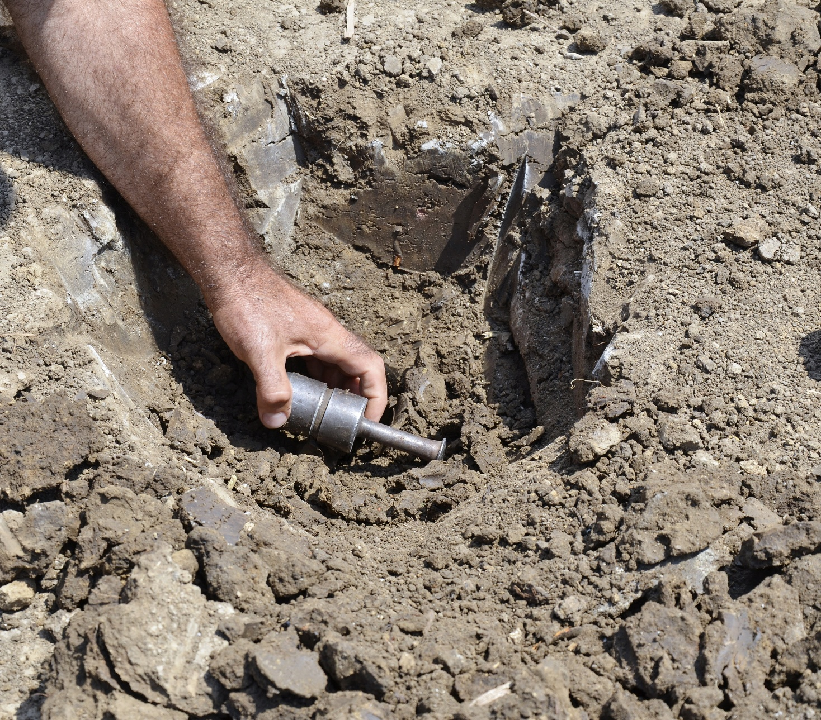
Example Careers in Geology
Mining and Energy Resources
Structural Geologist
Field Geologist
Mining and Production Geologist
Governmental - Regulatory
Geohazards
Seismologist
Vocanologist
Coastal Geologist
Engineering Geologist
Governmental - Regulatory
Academia and Research
Professor and teacher
Researcher
Museums – Outreach
Environmental Geology
Hydrogeologist
Geochemist
Governmental – Regulatory
Non-profit
Field geologist
3

Slide 4
Licensure Qualified Programs?
Most States require a degree in Geology, Engineering Geology, or Geological Engineering
Public Protection
Education
Exams
Experience
Common Degree Programs Include:
Environmental Geology
Environmental Science
Geoscience
Geology
Earth and Atmospheric Science
Environmental Studies
Earth and Planetary Sciences
Geophysics
Engineering Geology
Geotechnical Engineering
Geological Engineering
Hydrogeology
4

Slide 5
How to Apply
Familiarize yourself with the state board and review application instructions
Make sure you know the deadline for applications for your state.
State board reviews applications and approves candidates to take the exam
5

Slide 6
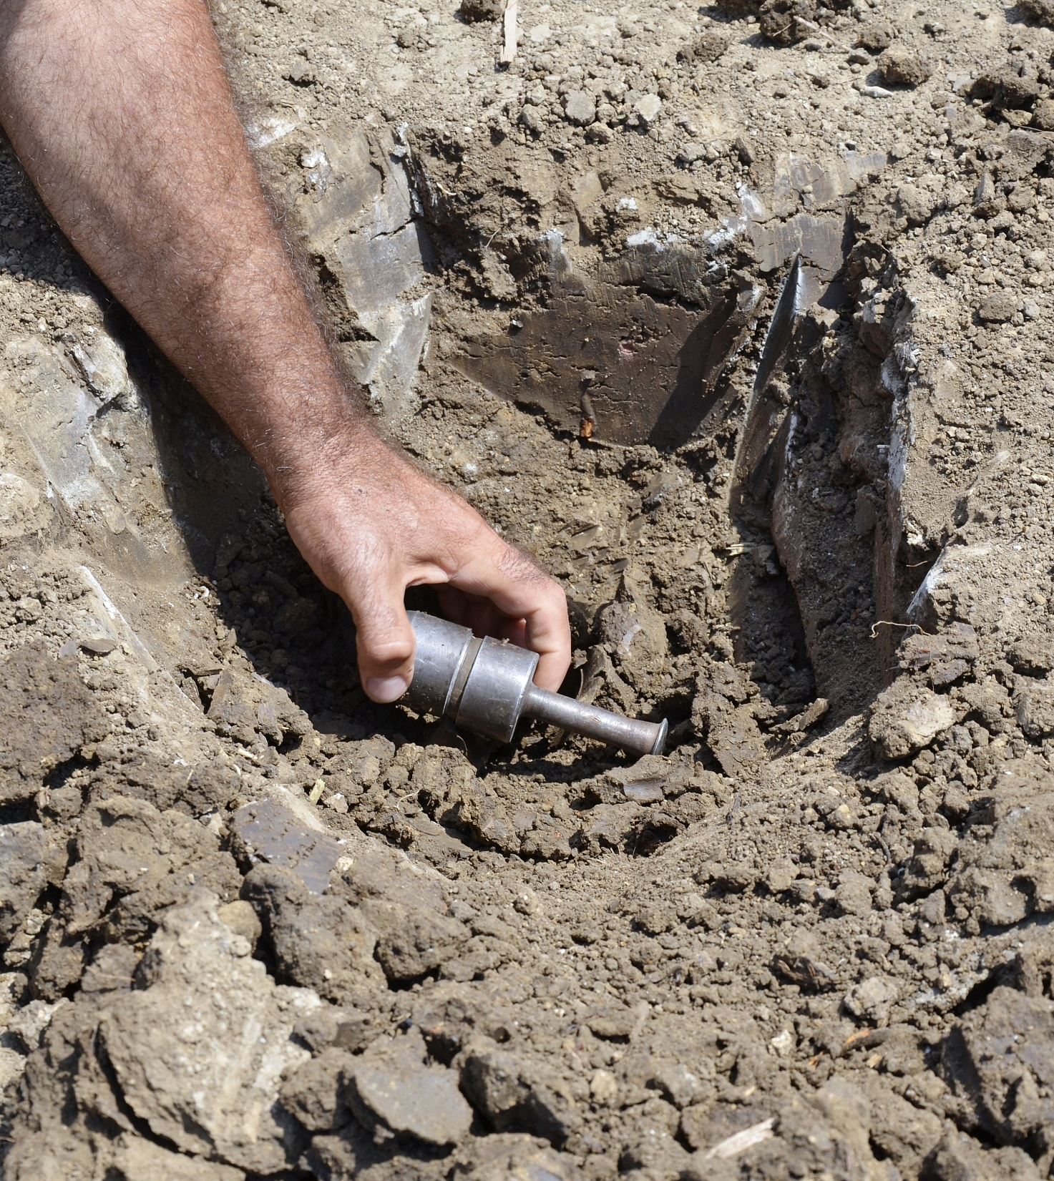
How to Register for Computer-Based Testing
Once your State Board has approved you to sit for an exam, you will receive an email from registrations@isoqualaitytesting.com that will contain instructions on how to register, pay and schedule their exam.
Follow the instructions on the email you receive and complete your registration at the IQT website (www.iqttesting.com) and sign in to register and schedule your exam.
After you have built your profile, and completed your Pre-Scheduling survey, pay your fees, and schedule the location, date, and time of your exam.
When you have selected your exam location, date, and time of your exam, you will receive your confirmation screen and must agree to the IQT Examination Agreement and submit.
Once you have submitted, you cannot change your exam arrangements.
You will receive a receipt and an admission document. You must print this page. It is your entry ticket into the testing center. If you losier your admission document, you can log back into your account to print another.
You will receive an email from Prometric/Iso-Quality Testing detailing your admission to the exam.
6

Slide 7

What (and what not) to Bring to an Exam?
Allowed Items:
Must bring a valid government-issued photo ID with a signature.
Non-QWERTY calculator (no cover)
Key to your test center locker
Eyeglasses (no cases)
Sweater or jacket
Admission letter
Prohibited Items:
Cell Phones
Handheld computers, or other electronic device, including watches
Head coverings (religious coverings are permitted)
Food and beverages
Bags, wallets, purses, coats
Books, notes, or any study-aid materials
* Any violation of prohibited items will result in immediate expulsion from testing center and forfeiture of exam privileges and fees.
7

Slide 8
About the Exams
Two parts to be fully licensed:
  Fundamentals of Geology (FG)
  Practice of Geology (PG)
Each test is multiple choice and is scheduled for 4 hours
  FG has 140 questions
  PG has 110 questions
Computer based exams
  Images for questions displayed on screen
  Question comments are encouraged
  Scratch paper and notes are permitted
Exams can be taken separately or on the same day
8

Slide 9
Fundamentals of Geology
Practice of Geology
Exam Framework
Minimum Requirements to Apply:
Graduate from a college or university with a degree in Geology or have completed 30 credit hours in geology, of which 24 are advanced level.
It is recommended that this exam be taken immediately after graduation. Statistics show that the FG pass rates decrease with time out of school
* Note: Requirements for each exam may vary by state.
Minimum Requirements to Apply:
FG requirements PLUS:
X years of geological experience. Job verification is required.
X professional references that can speak to your professional working experience (X must be PGs).
The FG exam focuses on information gained in an academic environment. 140 questions
The PG exam focuses on skills or knowledge applied in work setting. 110 questions.
The content is based on surveys of academic and professional geologists in the US and Canada every 5 years. Where the survey scales the importance of 43 geologic tasks in certain topics.
9

Slide 10
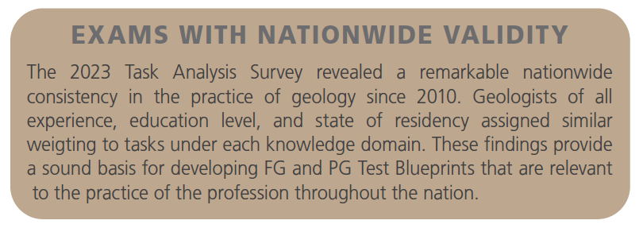
Exam Validity and Scoring
Designed to maximize fairness and quality
Exam questions are subjected to a minimum of four peer reviews
Credit is given for each correct answer, while no points are given for an incorrect response
ASBOG does not use a “fixed-percentage” passing scores and dies not grade on the curve
After each exam, a Council of Examiners comprised of Subject Matter Experts independently considers the performance, validity, and test taker comments for every question before the scores are finalized and issued to the state boards
Passing scores are adjusted based on the difficulty level of each question, so that candidates have the same possibility of passing any version of the exam
Manual regrades or proctored reviews are available, depending on your state board’s discretion and mandates
10

Slide 11
Exam Results
Results are available within 60 days of taking the exam.
You will receive an email from Prometric/or your state geology board indicating a PASS or FAIL.
Your state board will determine if any additional information regarding exam results will be provided to you.
ASBOG and Prometric will not provide/cannot provide any additional exam information.
11

Slide 12
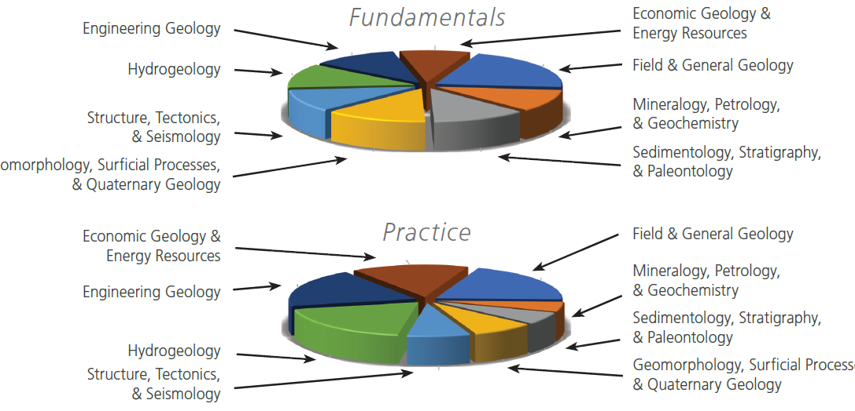
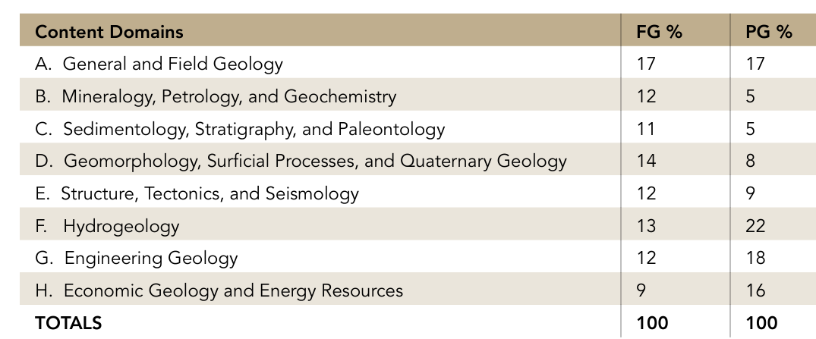
Exam Domains: Question Topics
12
    General and Field Geology is important to both exams
    Fundamentals exam is more balanced by domain
    Practice exam is more weighted toward engineering, environmental, and economic geology

Slide 13
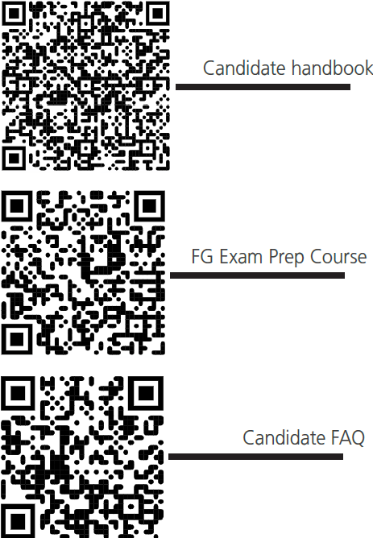
Additional Resources
    Download ASBOG’s Candidate handbook
      Includes detailed instructions for exams
      Information on blueprints and topics
      Sample questions
ASBOG offers an 8-hour FG prep course! Visit our website to register!
Visit Candidate Resources (asbog.org) for resources on preparing for your exam.
13

Slide 14
THANK YOU
https://www.asbog.org

